Slide 1
IoT-ENABLED HEALTHCARE ROBOTICS
EcoCare Rover
A Low-Cost IoT-Enabled Indoor Healthcare Assistance Rover with Remote Monitoring and Zone-Based Delivery
Mst. Esat Jahan Akhi • Jannatul Ferdusi Ayesha • Most. Sukria Akter
Presented To
Sadia Enam
Department of Internet of Things and Robotics Engineering (IRE), University of Frontier Technology, Bangladesh

Slide 2
01 OVERVIEW
Introduction & Motivation
1
Rising Care Burden
Routine transport of medicine, samples, water and supplies consumes staff time needed for direct patient care.
2
Growing Role of AMRs
Autonomous mobile robots, nursing robots and assistive service robots are emerging solutions for hospital logistics and elderly care.
3
High Cost & Complexity
Many existing platforms rely on ROS frameworks, complex localization and costly sensors — limiting adoption in small clinics.
4
Need for a Low-Cost IoT Solution
An affordable, embedded, cloud-connected rover can bring assistive delivery to resource-limited healthcare settings.
EcoCare Rover — Introduction
2 / 15

Slide 3
02 BACKGROUND
Related Work & Research Gap
What Prior Work Shows
The Gap EcoCare Rover Fills
Suharjono et al. — low-cost ESP32 nursing robot with ROS-based telemedicine, but high software complexity.
Wang et al. — reviewed AMRs in healthcare; highlighted cost and localization challenges.
Schmidt et al. — analyzed hospital-level robotic assistance, safety and integration barriers.
Combines manual smartphone control AND autonomous zone-based delivery in one platform.
Avoids ROS / heavy localization — lightweight ESP32-only embedded control.
Integrates obstacle detection, environmental monitoring and cloud supervision together.
Designed specifically for low-cost deployment in small clinics and elderly-care settings.
EcoCare Rover — Related Work
3 / 15

Slide 4
03 CONTRIBUTIONS
Proposed System
EcoCare Rover is an ESP32-based, IoT-enabled autonomous indoor delivery rover built to support hospitals, elderly-care centers and smart indoor healthcare environments.
1
2
3
4
Low-Cost Embedded Platform
Dual Operating Modes
Obstacle & Environment Aware
Cloud Synchronization
Sensing, control and IoT communication integrated on a single affordable ESP32 board.
Blynk-based manual control and autonomous zone-based delivery in one system.
HC-SR04 obstacle detection and DHT22 environmental monitoring with buzzer alerts.
Real-time and historical data visualization via the ThingSpeak IoT platform.
EcoCare Rover — Proposed System
4 / 15

Slide 5
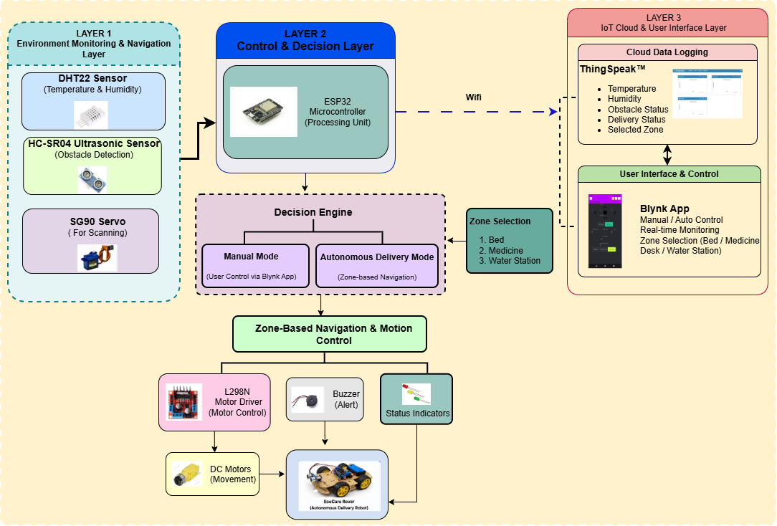
04 THREE-LAYER DESIGN
System Architecture
1
Layer 1 — Sensing
DHT22 (temperature & humidity), HC-SR04 ultrasonic (obstacle detection), SG90 servo (sensor scanning).
2
Layer 2 — Control & Decision
[ Insert Fig. 1 — System Architecture Diagram Here ]
ESP32 microcontroller runs the decision engine: manual mode vs. autonomous zone-based delivery.
3
Layer 3 — IoT Cloud & UI
Blynk app for control & monitoring; ThingSpeak for cloud data logging and visualization.
Fig. 1. System architecture of the proposed EcoCare Rover illustrating sensing, decision-making, IoT communication, and robotic actuation layers.
EcoCare Rover — System Architecture
5 / 15

Slide 6
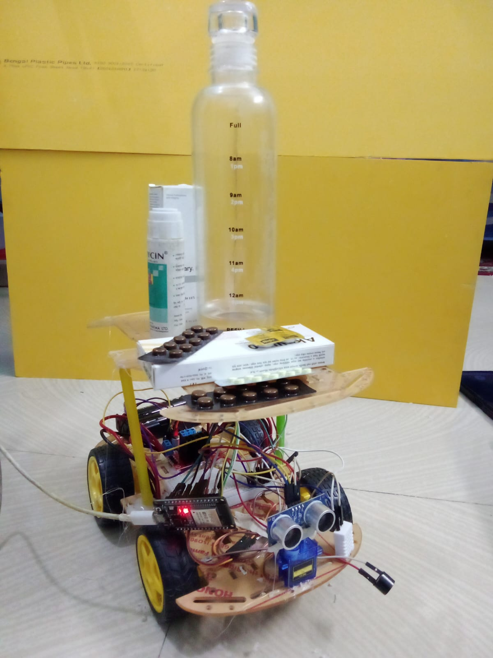
05 TABLE II
Hardware Components
Component | Function
ESP32 Development Board | Main Controller and Wi-Fi Communication
HC-SR04 Ultrasonic Sensor | Obstacle Detection
DHT22 Sensor | Temperature and Humidity Monitoring
SG90 Servo Motor | Ultrasonic Sensor Rotation
L298N Motor Driver | DC Motor Control
DC Gear Motors | Rover Locomotion
Buzzer | Obstacle Alert Notification
Li-ion Battery Pack | Power Supply
Robot Chassis | Mechanical Platform
[ Insert Rover Photo Here ]
Fig. 5. EcoCare Rover prototype hardware assembly.
EcoCare Rover — Hardware
6 / 15

Slide 7
06 TABLE III
Estimated Prototype Cost
Component | Estimated Cost (BDT)
ESP32 Development Board | 850
HC-SR04 Ultrasonic Sensor | 200
DHT22 Sensor | 550
SG90 Servo Motor | 300
L298N Motor Driver | 400
DC Gear Motors | 850
Robot Chassis | 1100
Battery Pack | 900
Miscellaneous Components | 500
TOTAL ESTIMATED COST
৳ 5,650
BDT (~ USD 46)
Prices reflect local Bangladeshi market rates and may vary with supplier, availability, and exchange rate fluctuations.
EcoCare Rover — Cost Estimation
7 / 15

Slide 8
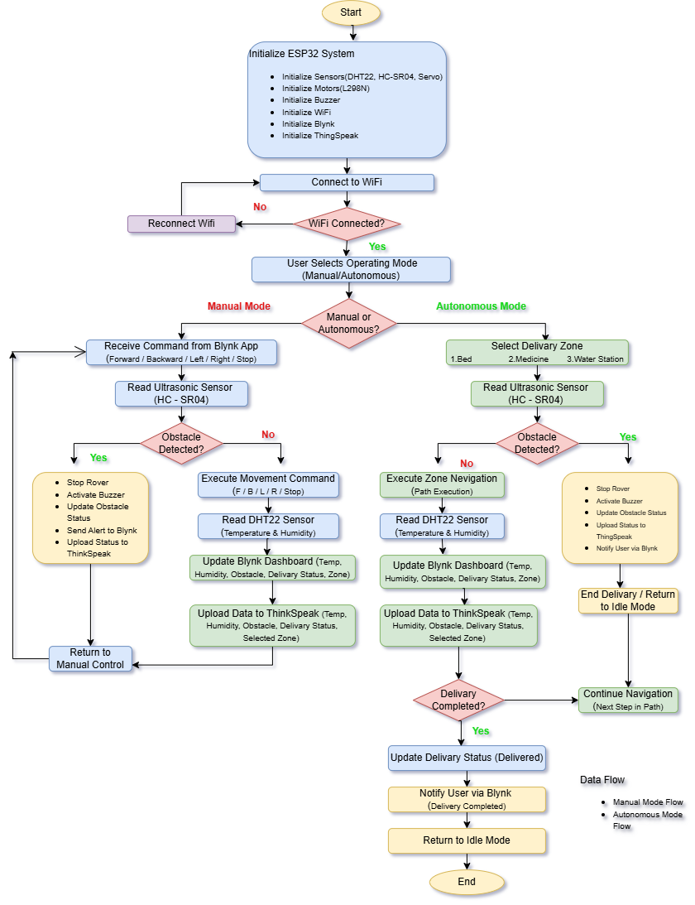
07 OPERATIONAL SEQUENCE
Software Workflow
Key Steps
System initialization — configure sensors, motor driver, Wi-Fi, Blynk and ThingSpeak.
Continuous processing of sensor data, user commands and rover status.
Manual mode — movement commands from Blynk app control rover motion.
Autonomous mode — selected delivery zone triggers a navigation sequence with obstacle monitoring.
Sensor and delivery data periodically uploaded to ThingSpeak cloud.
[ Insert Fig. 2 — Software Workflow Diagram Here ]
Fig. 2. Operational workflow of EcoCare Rover showing initialization, dual-mode control, obstacle-aware navigation, and cloud synchronization.
EcoCare Rover — Software Workflow
8 / 15

Slide 9
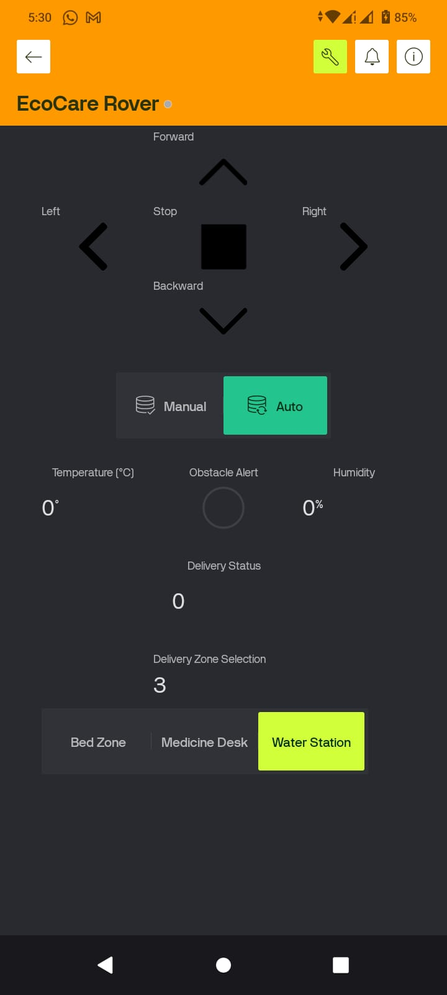
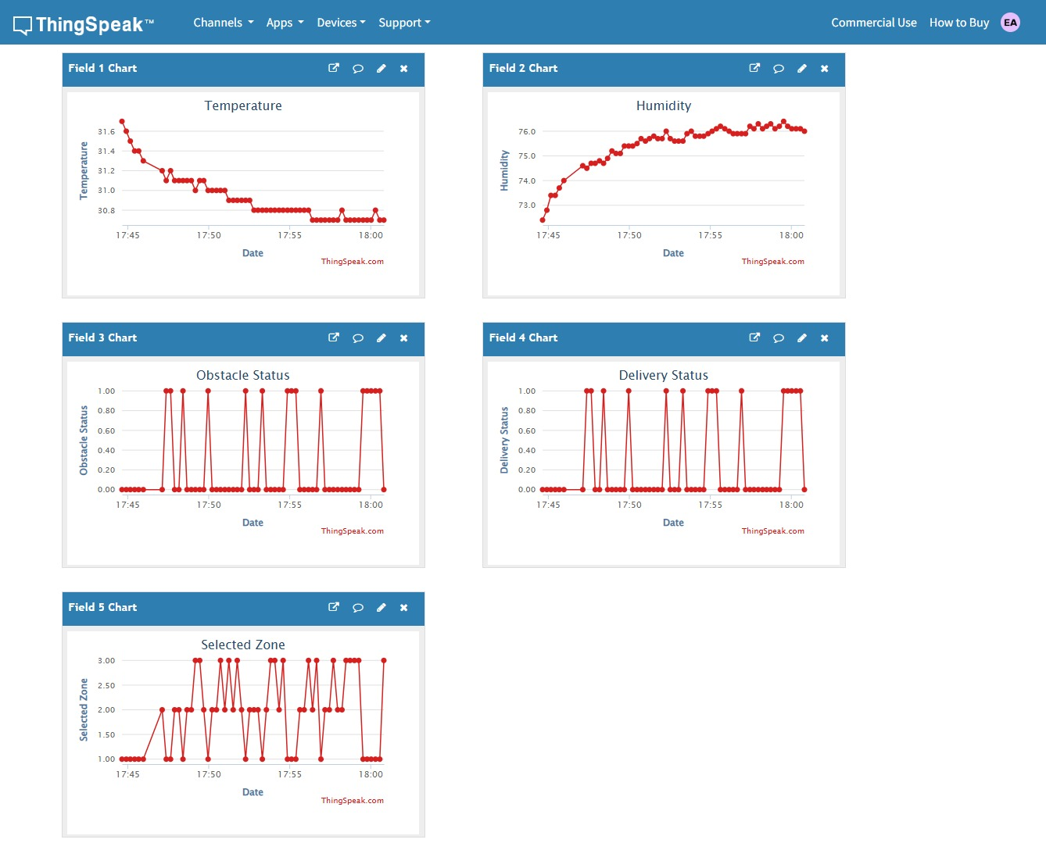
08 BLYNK & THINGSPEAK
IoT Integration
The ESP32 acts as the IoT gateway: Blynk provides the human–machine interface for control and monitoring, while ThingSpeak logs and visualizes environmental and operational data over time.
[ Insert Fig. 4 — ThingSpeak Dashboard Screenshot Here ]
Fig. 3. Blynk-based user interface for rover control, destination selection, and real-time system monitoring.
Fig. 4. ThingSpeak cloud dashboard showing real-time environmental monitoring and operational status visualization.
EcoCare Rover — IoT Integration
9 / 15

Slide 10
09 TABLE IV
Experimental Setup
Parameter | Specification
Programming IDE | Arduino IDE 2.x
Programming Language | C++
Cloud Platform | ThingSpeak
Mobile Platform | Blynk IoT
Communication | Wi-Fi (802.11 b/g/n)
Power Supply | 7.4 V Li-ion Battery Pack
Obstacle Threshold | 20 cm
ThingSpeak Update Interval | 15 s
Sensor Sampling Interval | 2 s
Operating Modes | Manual and Autonomous
Delivery Zones | Bed, Medicine, Water Station
Fig. 5. Developed EcoCare Rover prototype integrating the ESP32 controller, ultrasonic obstacle detection module, motor drive system, and healthcare delivery platform.
EcoCare Rover — Experimental Setup
10 / 15

Slide 11
10 TABLE V
Results & Performance
96.7%
98.2%
17.6 s
138 ms
100%
Autonomous Delivery
Success Rate (30 trials)
Obstacle Detection
Accuracy (50 tests)
Average
Delivery Time
Average Wi-Fi
Response Time
ThingSpeak Data
Upload Success
Manual control via Blynk responded reliably across forward, backward, left, right and stop commands. Autonomous zone-based delivery succeeded across bed, medicine and water-station destinations, with the ultrasonic sensor halting the rover and triggering the buzzer on obstacle detection.
EcoCare Rover — Results
11 / 15

Slide 12
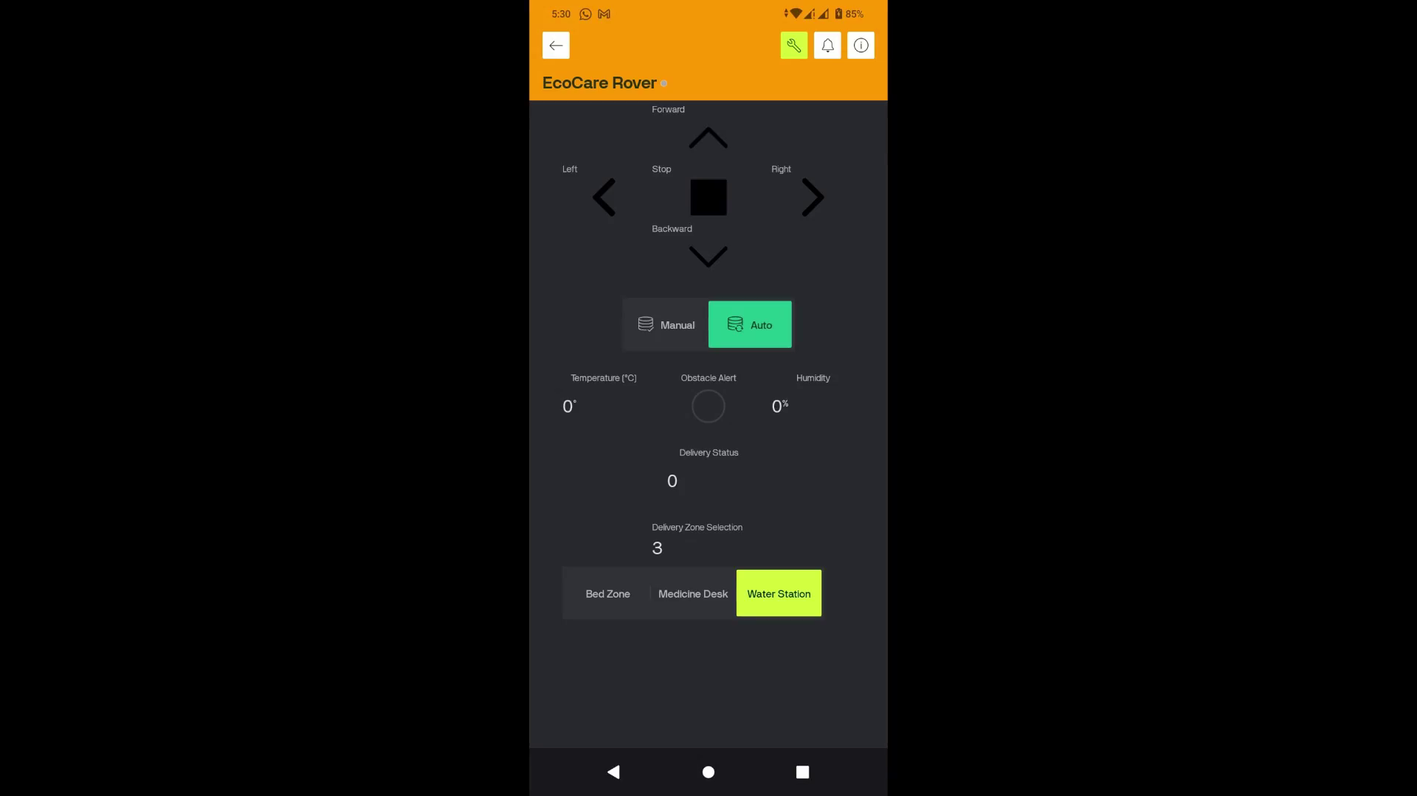
11 LIVE OPERATION
Video Demonstration
Embed or link the EcoCare Rover operation video (manual control + autonomous zone-based delivery) in this space.
Demo shows: Blynk manual navigation • Autonomous zone-based delivery • Obstacle detection & buzzer alert • Live ThingSpeak data sync
EcoCare Rover — Video Demonstration
12 / 15

Slide 13
12 COMPARATIVE ANALYSIS (2024–2025)
Literature Review
Study (Year) | ESP32 | IoT | Manual | Auto. | Obstacle | Env. | Cloud | Low Cost
Suharjono et al. (2025) | ✓ | ✓ | ✓ | ✓ | ✓ | × | ✓ | ×
Shin et al. (2025) | × | Partial | × | N/A | Partial | Partial | Partial | N/A
Wang et al. (2024) | × | Partial | N/A | N/A | Partial | Partial | Partial | N/A
Silvera-Tawil (2024) | × | Partial | N/A | N/A | Partial | Partial | Partial | N/A
Shaw et al. (2025) | × | Partial | × | Partial | × | Partial | Partial | N/A
Proposed EcoCare Rover | ✓ | ✓ | ✓ | ✓ | ✓ | ✓ | ✓ | ✓
EcoCare Rover is the only reviewed system to combine ESP32-based low-cost hardware with full IoT connectivity, dual manual/autonomous control, obstacle detection, environmental monitoring and cloud supervision.
EcoCare Rover — Literature Review
13 / 15

Slide 14
CONCLUSION & FUTURE WORK
Conclusion
EcoCare Rover demonstrates a practical, low-cost approach to indoor healthcare delivery — integrating zone-based autonomous delivery, Blynk-based manual control, environmental monitoring, obstacle detection, and ThingSpeak cloud supervision on a single ESP32 embedded platform. Experimental results confirm reliable navigation, real-time obstacle detection, and successful cloud synchronization.
Future Work
•
Advanced localization and SLAM for flexible navigation
•
Adaptive, real-time path planning beyond fixed routes
•
Vision-based perception for richer environment awareness
•
Intelligent decision-making for complex delivery scenarios
EcoCare Rover — Conclusion
14 / 15

Slide 15
13 LITERATURE REVIEW SOURCES
References
1
D. Silvera-Tawil, “Robotics in healthcare: A survey,” SN Computer Science, vol. 5, no. 1, p. 189, 2024.
2
H. Shin, S. Kim, E. Jung, Y. Han, N. Lee, S. Park, C. Jeon, and J. Woo, “A comprehensive review of autonomous mobile robots in healthcare: Implications for patient-transporting human-following robots,” Robotics, vol. 14, no. 12, p. 179, 2025.
3
R. J. Shaw and B. Chen, “Physical artificial intelligence in nursing: Robotics,” Nursing Outlook, vol. 73, no. 5, p. 102495, 2025.
4
B. Wang et al., “Advancing healthcare through mobile collaboration: A survey of human–robot interaction and autonomous mobile robots,” Healthcare, vol. 12, no. 23, p. 2434, 2024.
5
A. Suharjono, R. Apriantoro, B. Supriyo, E. D. Wardihani, B. Yunanto, W. Hidayat, K. Prasetio, R. Reynaldi, and A. F. Aji, “A low-cost nursing robot with telemedicine using esp32 and robot operating system-based,” International Journal on Informatics Visualization, vol. 9, no. 1, pp. 541–552, 2025.
Referenced studies correspond to the five papers (2024–2025) compared against the proposed EcoCare Rover in the Literature Review slide.
EcoCare Rover — References
15 / 15

